Slide 1


Calculus and applications
MTH10012
Week 1

Slide 2
Introduction
MODULE 1
Sets of numbers
  Real numbers, completeness, order, inequalities
Sets and their operations
  Intervals (open and close)
  Union, intersection, complement, subset, empty set
  Natural numbers and the induction principle
  Functions and their properties
    Definition of function, domain, range and graph
    Natural domain
    Composition of functions
    Inverse of a function

Slide 3

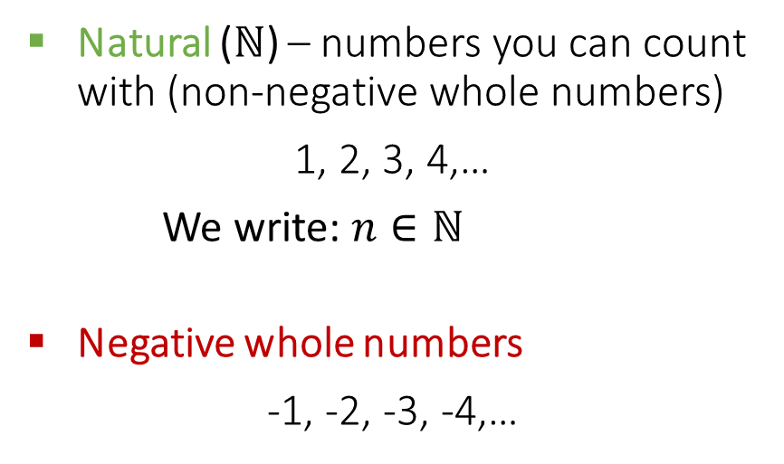
1.1 Numbers, sets, completeness and ordering
Natural ($ℕ$) – numbers you can count with (non-negative whole numbers)
1, 2, 3, 4,…
We write: $n∈ℕ$
Negative whole numbers
-1, -2, -3, -4,…
Together with zero they make:
Integer ($ℤ$) numbers
We write: $z∈ℤ$
7th century AD India to represent debt
– ꚙ
ꚙ
-3
-2
-1
0
1
2
3

Slide 4
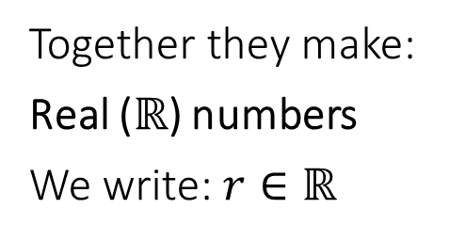
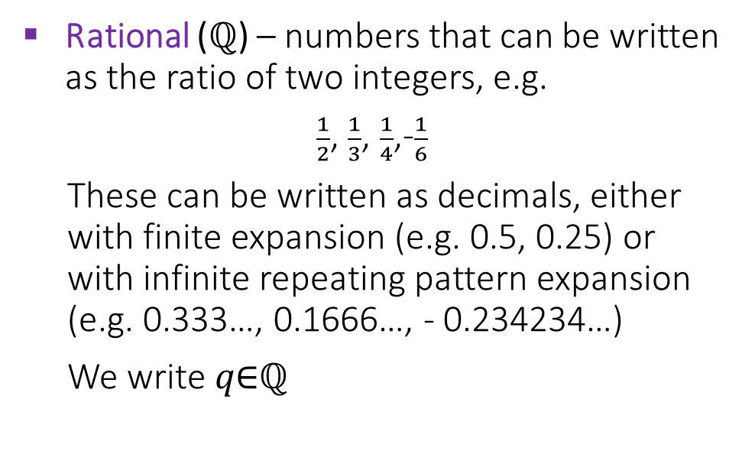



1.1 Numbers, sets, completeness and ordering
Rational ($ℚ$) – numbers that can be written as the ratio of two integers, e.g.
$\frac{1}{2}$, $\frac{1}{3}$, $\frac{1}{4}$,-$\frac{1}{6}$
These can be written as decimals, either with finite expansion (e.g. 0.5, 0.25) or with infinite repeating pattern expansion (e.g. 0.333…, 0.1666…, - 0.234234…)
We write 𝑞∈ℚ
Together they make:
Real ($ℝ$) numbers
We write: $r∈ℝ$
$$\frac{1}{2}$$
1.5
$$\frac{7}{3}$$
Irrational – numbers that cannot be written as a ratio of two integers.
These can be written as decimals with infinite non-repeating pattern expansion.
– ꚙ
ꚙ
-3
-2
-1
0
1
2
3
$$\sqrt{2}=1.414213…$$
e
π=3.14159…
ϕ=1.6180339…

Slide 5

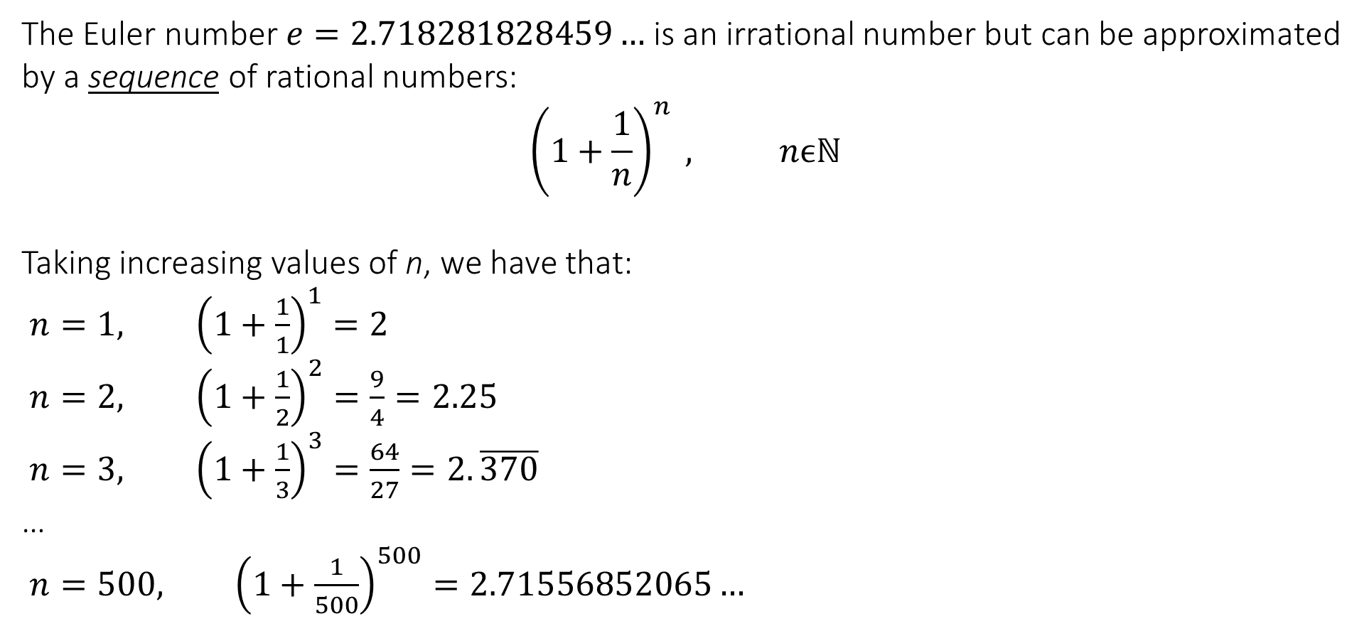



1.1 Numbers, sets, completeness and ordering
The Euler number $e=2.718281828459…$ is an irrational number but can be approximated by a sequence of rational numbers:
$${\left(1+\frac{1}{n}\right)}^{n} , nϵℕ$$
Taking increasing values of n, we have that:
$n=1, {\left(1+\frac{1}{1}\right)}^{1}=2$
$n=2, {\left(1+\frac{1}{2}\right)}^{2}=\frac{9}{4}=2.25$
$n=3, {\left(1+\frac{1}{3}\right)}^{3}=\frac{64}{27}=2.\overline{370}$
…
$n=500, {\left(1+\frac{1}{500}\right)}^{500}=2.71556852065…$
1
$$3$$
$$500$$
$$2$$
– ꚙ
ꚙ
-3
-2
-1
0
1
2
3
e
$$\lim_{n→∞}{{\left(1+\frac{1}{n}\right)}^{n}=e}$$

Slide 6
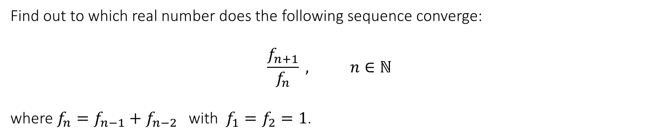
1.1 Numbers, sets, completeness and ordering
Find out to which real number does the following sequence converge:
$$\frac{f_{n+1}}{f_{n}} , n∈ℕ$$
where $f_{n}=f_{n−1}+f_{n−2}$ with $f_{1}=f_{2}=1$.

Slide 7



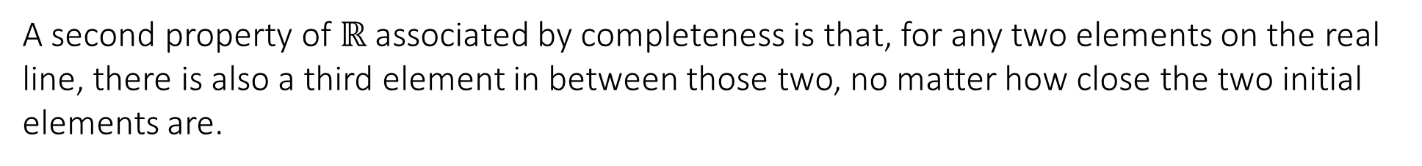
1.1 Numbers, sets, completeness and ordering
Completeness of $ℝ$
This means that sequences such as the one used to approximate e will converge to an element in $ℝ$.
A second property of $ℝ$ associated by completeness is that, for any two elements on the real line, there is also a third element in between those two, no matter how close the two initial elements are.
$$2.7$$
$$2.8$$
There are no “gaps” in the real number line
– ꚙ
ꚙ
-3
-2
-1
0
1
2
3
e

Slide 8
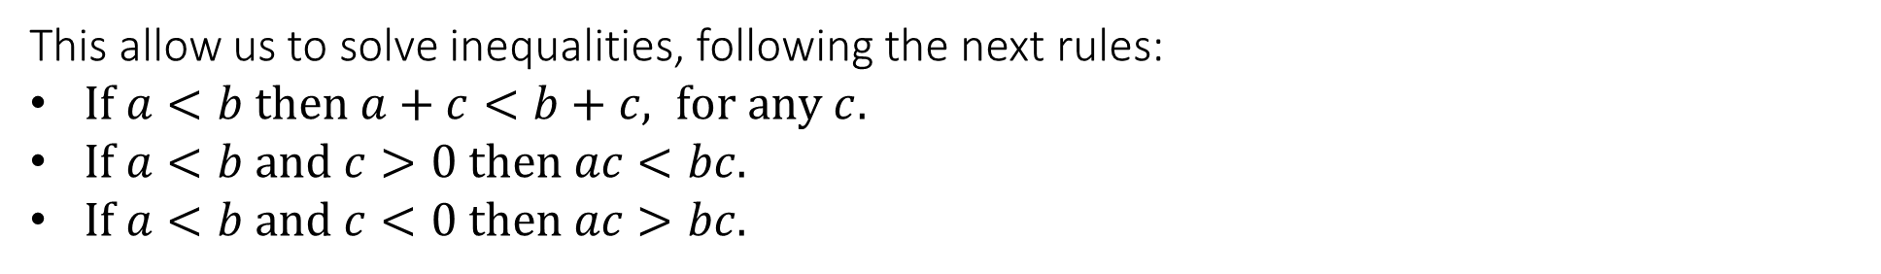
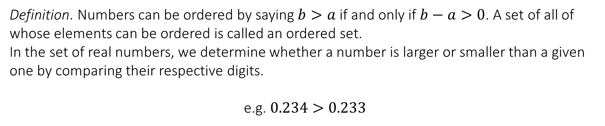
1.1 Numbers, sets, completeness and ordering
Ordering and inequalities
Definition. Numbers can be ordered by saying $b>a$ if and only if $b−a>0$. A set of all of whose elements can be ordered is called an ordered set.
In the set of real numbers, we determine whether a number is larger or smaller than a given one by comparing their respective digits.
e.g. $0.234>0.233$
This allow us to solve inequalities, following the next rules:
$If a<b then a+c<b+c, for any c.$
$If a<b and c>0 then ac<bc.$
$If a<b and c<0 then ac>bc.$

Slide 10


1.2 Sets and their operations
Sets and their operations
Definition. In $ℝ$, the set of numbers between two elements $aεℝ,bεℝ$, excluding a and b themselves, is called an open interval, and denoted $(a,b)$, i.e. $\left(a,b\right)=\left\{xεℝ | a<x<b\right\}$
– ꚙ
ꚙ
$$A=(−1,2)$$
-3
-2
-1
0
1
2
3
Definition. In $ℝ$, the set of numbers between two elements $aεℝ,bεℝ$, including a and b themselves, is called a closed interval, and denoted $[a,b]$, i.e. $\left[a,b\right]=\left\{xεℝ | a≤x≤b\right\}$
– ꚙ
ꚙ
$$B=[−1,2]$$
-3
-2
-1
0
1
2
3

Slide 11
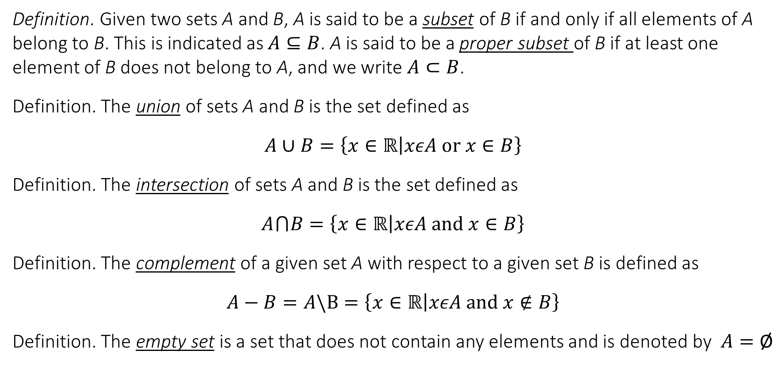
1.2 Sets and their operations
Definition. Given two sets A and B, A is said to be a subset of B if and only if all elements of A belong to B. This is indicated as $A⊆B$. A is said to be a proper subset of B if at least one element of B does not belong to A, and we write $A⊂B$.
Definition. The union of sets A and B is the set defined as
$$A∪B=\left\{x∈ℝ | xεA or x∈B\right\}$$
Definition. The intersection of sets A and B is the set defined as
$$A⋂B=\left\{x∈ℝ | xεA and x∈B\right\}$$
Definition. The complement of a given set A with respect to a given set B is defined as
$$A−B=A\backslash B=\left\{x∈ℝ | xεA and x∉B\right\}$$
Definition. The empty set is a set that does not contain any elements and is denoted by $A=\text{Ø}$

Slide 12
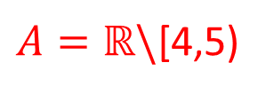
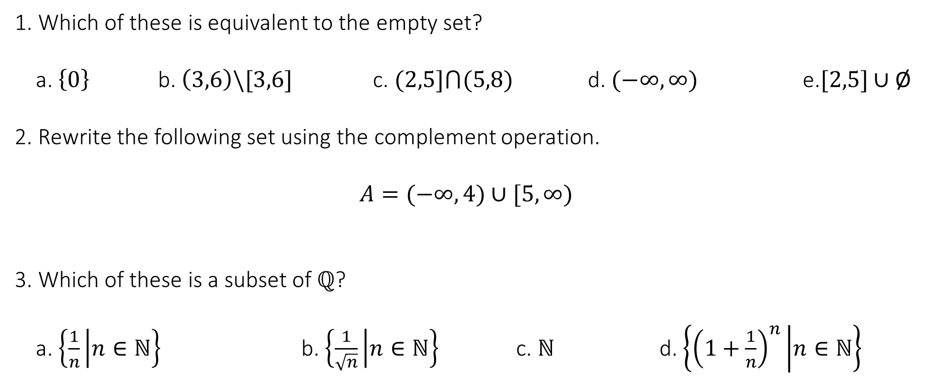
Test your knowledge
1. Which of these is equivalent to the empty set?
a. $\left\{0\right\}$ b. $\left(3,6\right)\backslash [3,6]$ c. $(2,5]⋂(5,8)$ d. $(−∞,∞)$ e.$[2,5]∪\text{Ø}$
2. Rewrite the following set using the complement operation.
$$A=(−∞,4)∪[5,∞)$$
3. Which of these is a subset of $ℚ$?
a. $\left\{\frac{1}{n} | n∈ℕ\right\}$ b. $\left\{\frac{1}{\sqrt{n}} | n∈ℕ\right\}$ c. $ℕ$ d. $\left\{{\left(1+\frac{1}{n}\right)}^{n} | n∈ℕ\right\}$
$A=ℝ\backslash$[4,5)

Slide 14
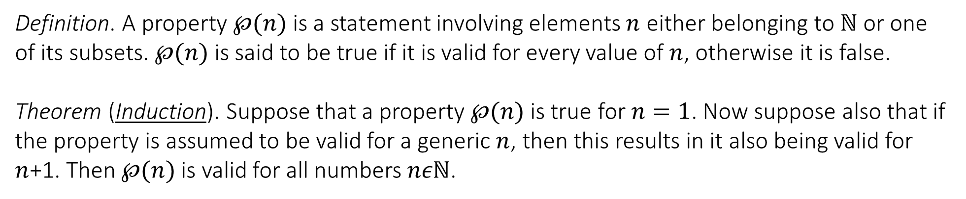
1.3 The induction principle
Induction principle
Definition. A property $℘(n)$ is a statement involving elements $n$ either belonging to $ℕ$ or one of its subsets. $℘(n)$ is said to be true if it is valid for every value of $n$, otherwise it is false.
Theorem (Induction). Suppose that a property $℘(n)$ is true for $n=1$. Now suppose also that if the property is assumed to be valid for a generic $n$, then this results in it also being valid for $n$+1. Then $℘(n)$ is valid for all numbers $nεℕ$.

Slide 15
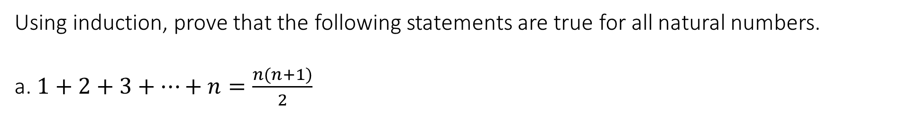
1.3 The induction principle
Induction principle
Using induction, prove that the following statements are true for all natural numbers.
a. $1+2+3+…+n=\frac{n(n+1)}{2}$

Slide 16
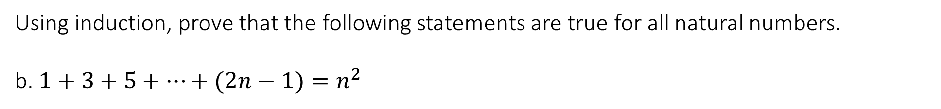
1.3 The induction principle
Induction principle
Using induction, prove that the following statements are true for all natural numbers.
b. $1+3+5+…+(2n−1)=n^{2}$

Slide 17
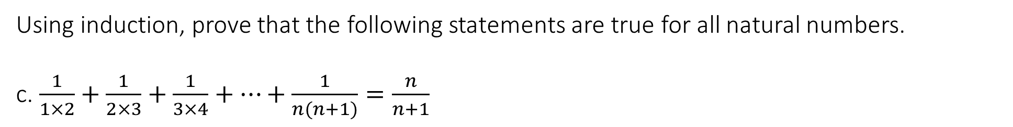
1.3 The induction principle
Induction principle
Using induction, prove that the following statements are true for all natural numbers.
c. $\frac{1}{1×2}+\frac{1}{2×3}+\frac{1}{3×4}+…+\frac{1}{n(n+1)}=\frac{n}{n+1}$

Slide 19
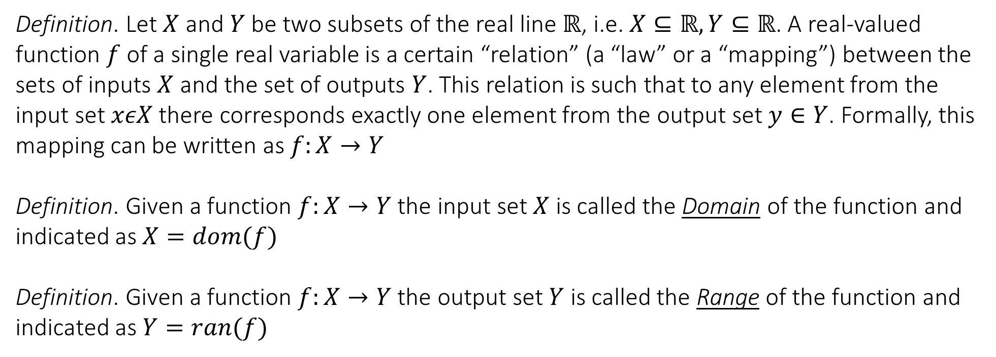
1.4 Functions and their properties
Definition of function, domain, range and graph
Definition. Let $X$ and $Y$ be two subsets of the real line $ℝ$, i.e. $X⊆ℝ,Y⊆ℝ$. A real-valued function $f$ of a single real variable is a certain “relation” (a “law” or a “mapping”) between the sets of inputs $X$ and the set of outputs $Y$. This relation is such that to any element from the input set $xεX$ there corresponds exactly one element from the output set $y∈Y$. Formally, this mapping can be written as $f:X→Y$
Definition. Given a function $f:X→Y$ the input set $X$ is called the Domain of the function and indicated as $X=dom(f)$
Definition. Given a function $f:X→Y$ the output set $Y$ is called the Range of the function and indicated as $Y=ran(f)$

Slide 20
1.4 Functions and their properties
RED
GREEN
BLUE
YELLOW
PURPLE

Slide 21
1.4 Functions and their properties
CIRCLE
TRIANGLE
PENTAGON
SQUARE
HEXAGON

Slide 22
1.4 Functions and their properties
Student 1
Student 2
Student 3
Student 4
Student 5
Professor 1
Professor 2
Professor 3

Slide 23
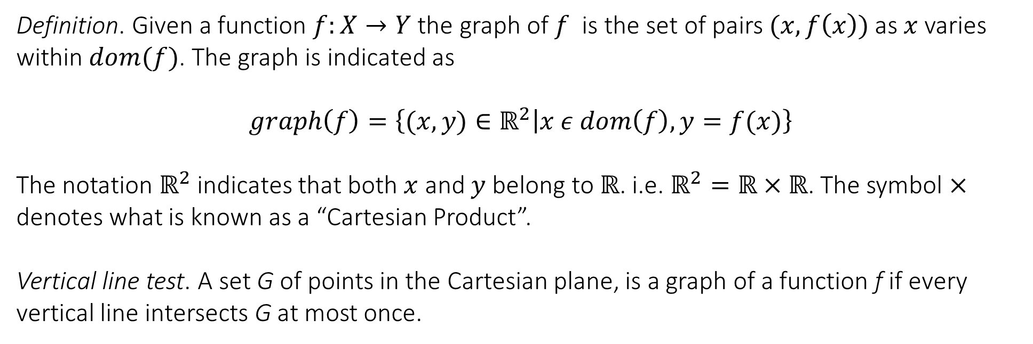
1.4 Functions and their properties
Definition of function, domain, range and graph
Definition. Given a function $f:X→Y$ the graph of $f$ is the set of pairs $(x,f\left(x\right))$ as $x$varies within $dom(f)$. The graph is indicated as
$$graph\left(f\right)=\left\{(x,y)∈ℝ^{2} | x ε dom\left(f\right),y=f(x)\right\}$$
The notation $ℝ^{2}$ indicates that both $x$ and $y$ belong to $ℝ$. i.e. $ℝ^{2}=ℝ×ℝ$. The symbol $×$ denotes what is known as a “Cartesian Product”.
Vertical line test. A set G of points in the Cartesian plane, is a graph of a function f if every vertical line intersects G at most once.

Slide 24
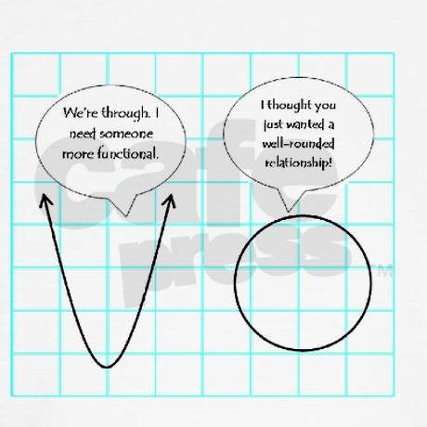






1.4 Functions and their properties
$$y$$
$$y=x^{2}$$
$$y$$
$$y^{2}+x^{2}=9$$
*
*
0
$$x$$
0
$$x$$
*
This is not a function because there are more than one value of y for each x.

Slide 25
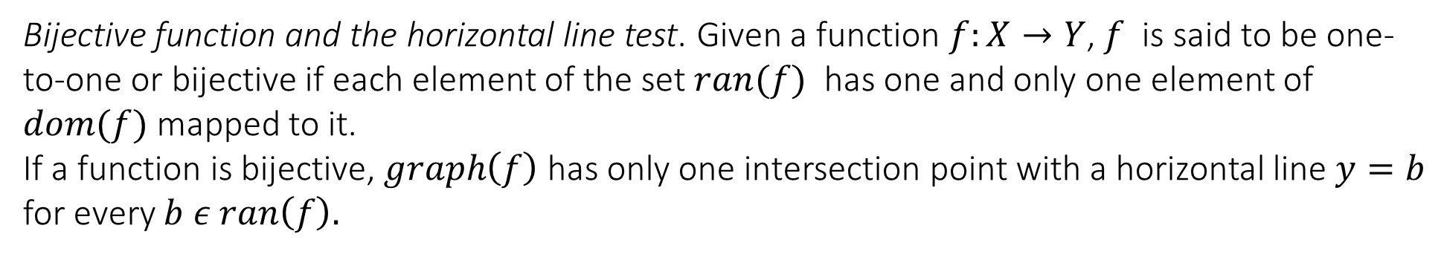
1.4 Functions and their properties
Bijective function and the horizontal line test. Given a function $f:X→Y$, $f$ is said to be one-to-one or bijective if each element of the set $ran(f)$ has one and only one element of $dom(f)$ mapped to it.
If a function is bijective, $graph\left(f\right)$ has only one intersection point with a horizontal line $y=b$ for every $b ε ran\left(f\right).$
RED
GREEN
BLUE
YELLOW
PURPLE

Slide 26
1.4 Functions and their properties

Slide 27
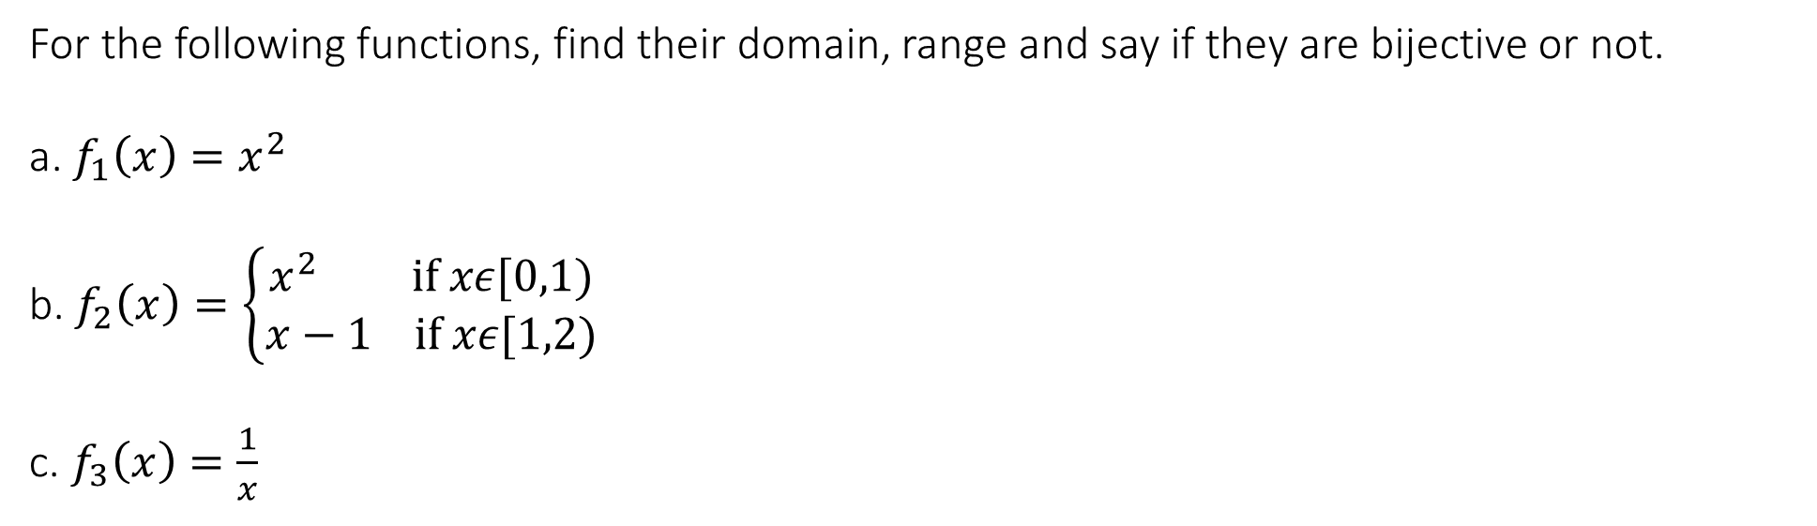
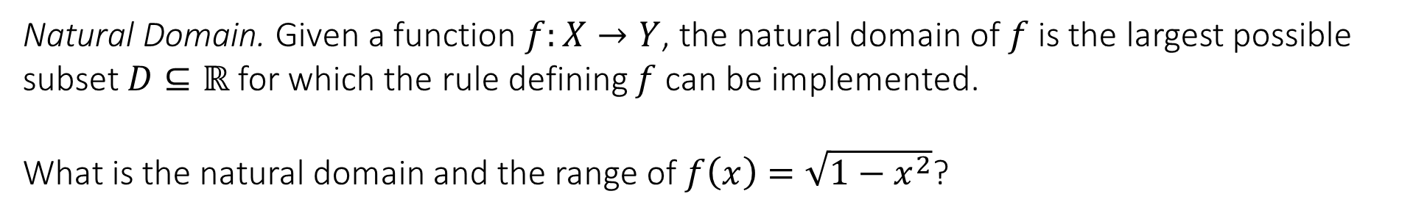
1.4 Functions and their properties
For the following functions, find their domain, range and say if they are bijective or not.
a. $f_{1}\left(x\right)=x^{2}$
b. $f_{2}\left(x\right)=\left\{\begin{matrix}x^{2} if xε[0,1) \\ x−1 if xε[1,2)\end{matrix} \right.$
c. $f_{3}\left(x\right)=\frac{1}{x}$
Natural Domain. Given a function $f:X→Y$, the natural domain of $f$is the largest possible subset $D⊆ℝ$ for which the rule defining $f$can be implemented.
What is the natural domain and the range of $f\left(x\right)=\sqrt{1−x^{2}}$?

Slide 29

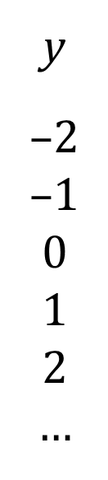

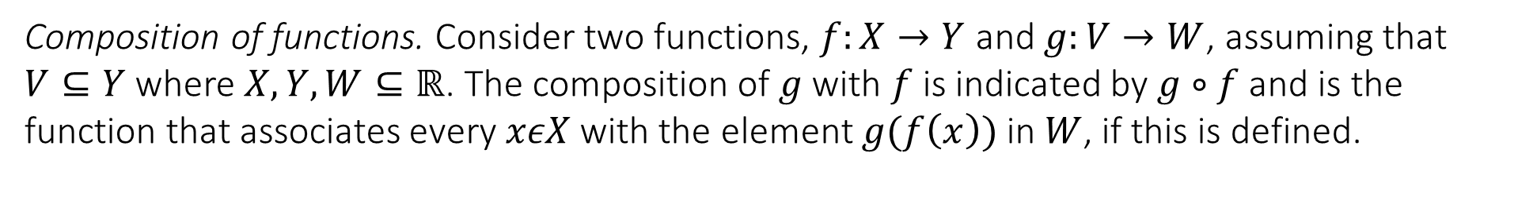



1.4 Functions and their properties
Composition of functions. Consider two functions, $f:X→Y$ and $g:V→W$, assuming that $V⊆Y$ where $X,Y,W⊆ℝ$. The composition of $g$with $f$ is indicated by $g∘f$ and is the function that associates every $xεX$ with the element $g(f\left(x\right))$ in $W$, if this is defined.
$$g\left(f\left(x\right)\right)=\sqrt{x+1}$$
Y
$$V⊆Y$$
X
W
x
–3
–2
–1
0
1
…
y
–2
–1
0
1
$$2$$
…
$$f\left(x\right)=x+1$$
$$g\left(x\right)=\sqrt{x}$$
w
0
1
$$\sqrt{2}$$
…

Slide 30
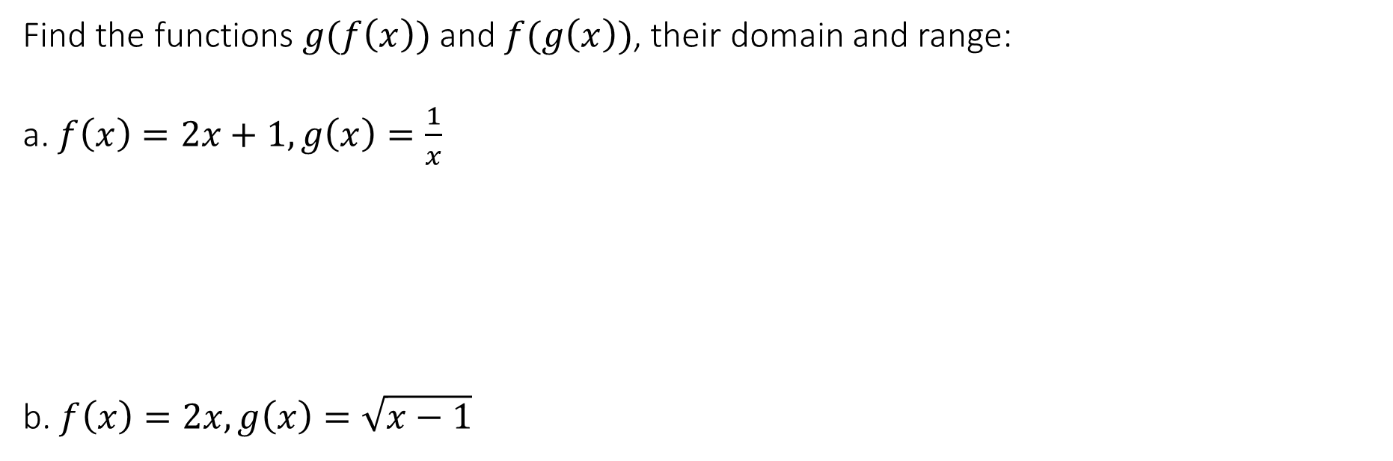
1.4 Functions and their properties
Find the functions $g(f\left(x\right))$ and $f(g\left(x\right))$, their domain and range:
a. $f\left(x\right)=2x+1, g\left(x\right)=\frac{1}{x}$
b. $f\left(x\right)=2x, g\left(x\right)=\sqrt{x−1}$

Slide 31
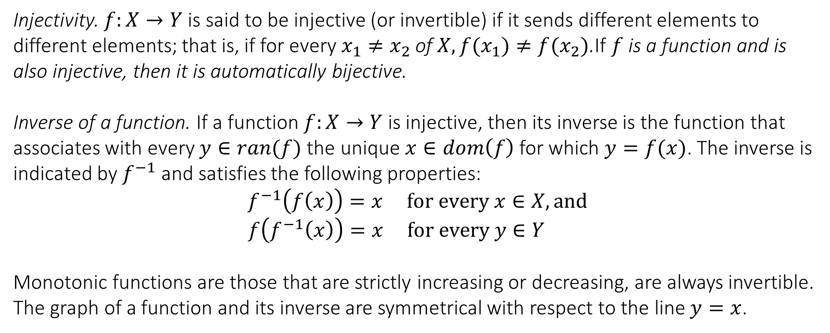
1.4 Functions and their properties
Injectivity. $f:X→Y$ is said to be injective (or invertible) if it sends different elements to different elements; that is, if for every $x_{1}≠x_{2}$ of $X, f(x_{1})≠f(x_{2})$.If $f$ is a function and is also injective, then it is automatically bijective.
Inverse of a function. If a function $f:X→Y$ is injective, then its inverse is the function that associates with every $y∈ran(f)$ the unique $x∈dom\left(f\right)$ for which $y=f(x)$. The inverse is indicated by $f^{−1}$ and satisfies the following properties:
$$f^{−1}\left(f\left(x\right)\right)=x for every x∈X, and$$
$$f\left(f^{−1}\left(x\right)\right)=x for every y∈Y$$
Monotonic functions are those that are strictly increasing or decreasing, are always invertible.
The graph of a function and its inverse are symmetrical with respect to the line $y=x$.

Slide 32

1.4 Functions and their properties
For the following functions, find if they are invertible or not. If they are invertible, find their inverse. If they are not invertible, find if by restricting their domain you can make them invertible.
a. $f\left(x\right)=x^{3}$
b. $f\left(x\right)=x^{2}$
c. $f\left(x\right)=x^{2}−4x+5$

Slide 33
End of Lecture

